Slide 1

DiabeTES PREDICITON
SESSION -2020-21
Mentor
Mohd. Amir Khan
Efforts By
Janvi Pangoriya
Nidhi Gupta

Slide 2
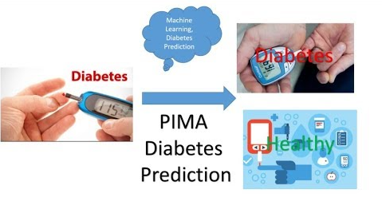
OBJECTIVE
The ultimate aim of this project is to predict the probability of having diabetes.

Slide 3
DIABETES PREDICITON
Diabetes is a group of metabolic disorders in which there are high blood sugar levels over a prolonged period.
If left untreated, diabetes can cause many complications. Serious long-term complications include cardiovascular disease, stroke, chronic kidney disease, foot ulcers, and damage to the eyes.

Slide 4
Why DIABETES PREDICITON?
According to WHO about 422 million people suffering from diabetes particularly from low or idle income countries. And this could be increased to 490 billion up to the year of 2030.
Population of India is now more than 100 million so the actual number of diabetics in India is 40 million..

Slide 5
dataset
Training data consist of 749 entries. It has the following columns:
Pregnancies: Number of times pregnant
Glucose: Plasma glucose concentration a 2 hours in an oral glucose tolerance test
Blood Pressure: Diastolic blood pressure (mm Hg)
Skin Thickness: Triceps skin fold thickness (mm)
Insulin: 2-Hour serum insulin (mu U/ml)
BMI: Body mass index (weight in kg/(height in m)^2)
Diabetes Pedigree Function: Diabetes pedigree function
Age: Age (years)
Outcome: Class variable (0 or 1)owing columns

Slide 6
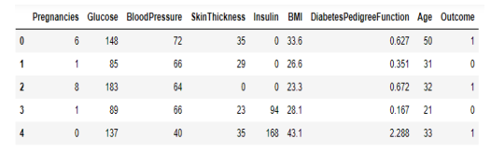
Continued …..

Slide 7
METHODOLOGY
FLOWCHART
Dataset
Preprocessing
Data
visualization
Building
Model
Result
Analysis
Deployed
testing

Slide 8
PREPROCESSING
It includes the cleaning of the dataset like to check if there a null value in any of the attribute which is being considered for evaluation

Slide 9
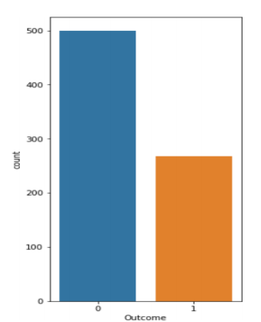
Bar Plot
Representation technique.
It shows the relationship
between a numeric and
categorical variable.
The size of the bar
represents its numeric value.

Slide 10
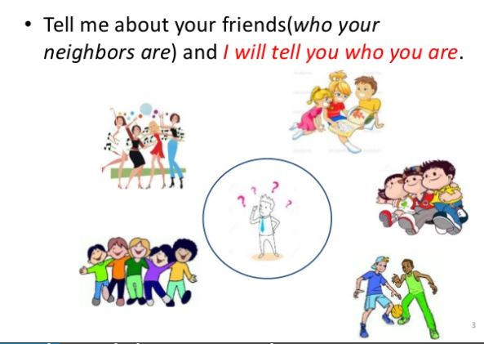
Model building
K-Nearest Neighbors (KNN):

Slide 11
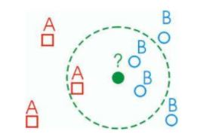
Continue…
K nearest neighbors stores all available case and classifies new cases based on a similarity measure(e.g. distance function)
The object is classified by a majority votes for its k-neighbor classes.

Slide 12
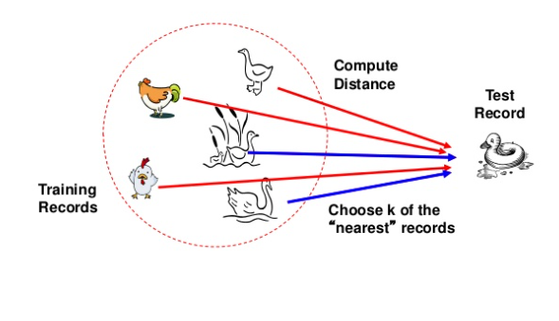
Prediction on test data

Slide 13
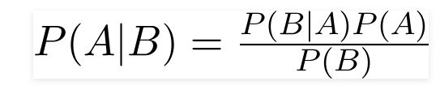
Naïve bayes
It is a probabilistic machine learning model that’s used for classification task.
The crux of the classifier is based on the Bayes theorem.

Slide 14
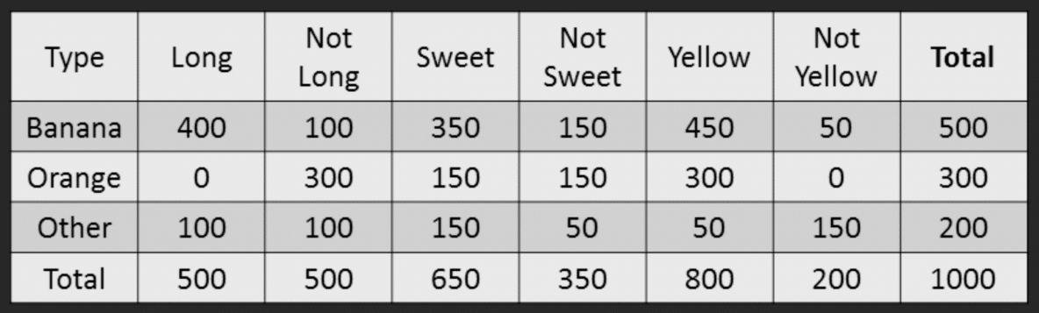
Example

Slide 15
Step 1: Compute the ‘Prior’ probabilities for each of the class of fruits.
P(Y= Banana) = 500 / 1000 = 0.50
P(Y= Orange) = 300 / 1000 = 0.30
P(Y= Other) = 200 / 1000 = 0.20
Step 2: Compute the probability of evidence that goes in the denominator.
P(x1=Long) = 500 / 1000 = 0.50
P(x2=Sweet) = 650 / 1000 = 0.65
P(x3=Yellow) = 800 / 1000 = 0.80

Slide 16
Step 3: Compute posterior probability
Probability of Likelihood for Banana
P(x1=Long | Y=Banana) = 400 / 500 = 0.80
P(x2=Sweet | Y=Banana) = 350 / 500 = 0.70
P(x3=Yellow | Y=Banana) = 450 / 500 = 0.90
The overall probability of Likelihood of evidence for Banana = 0.8 * 0.7 * 0.9 = 0.504
Similarly calculate the probability of other fruits
Step 4: Prediction
If a fruit is ‘Long’, ‘Sweet’ and ‘Yellow’, What fruit is it?
P(Banana | Long, Sweet and yellow) = 0.8 * 0.7 *0.9*0.5 =0.252
P(Orange | Long, Sweet and yellow) = 0 (P (long |orange)=0)
P(Other | Long, Sweet and yellow) = 0.01875
Fruit is Banana since it has highest probability amongst the 3 classes

Slide 17
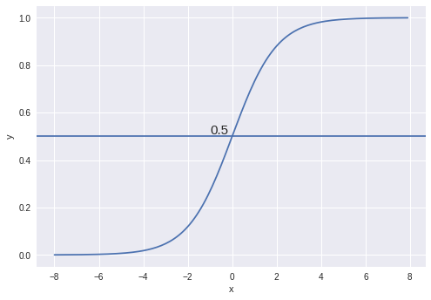
Logistic regression
Used to describe data and to explain the relationship between one dependent binary variable and one or more nominal, ordinal, interval variables.
Hypothesis :
Z = β₀ + β₁X
hΘ(x) = sigmoid(Z)
hΘ(x) = 1/(1 + e^-(β₀ + β₁X)

Slide 18
Categorical Response Variables
Examples:
Smoker
NON-SMOKER
Whether or not a person smokes’
Binary Response
Success of a medical treatment
Diabetic
Non-diabetic
Opinion poll responses
AGREE
DISAGREE
NEUTRAL
Ordinal Response

Slide 19
Decision Boundary

Slide 20
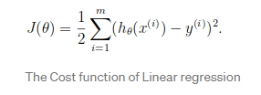
Cost Function

Slide 21
Decision tree
It is a tree in which each branch node represents a choice between a number of alternatives, and each leaf node represent a decision.
Information gain decides which attribute goes into a decision node.
To minimize the decision tree depth , the attribute with the most entropy reduction is the choice!

Slide 22
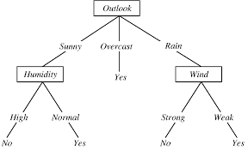
Example

Slide 23
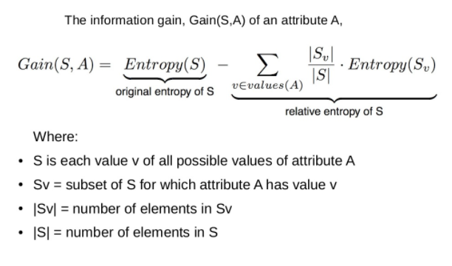
Information Gain

Slide 24
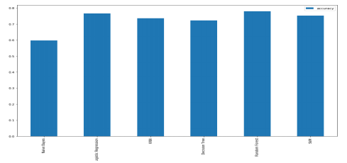
Comparison plot

Slide 25
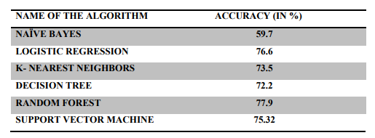
TABLE OF ACCURACY

Slide 26
Deployment
Model Deployment can be defined as the model that is kept in a production environment or a server where it takes input from the user and gives output in real-time.
We are doing deploying our project using Flask API
on Heroku platform
Link of our project:
https://diabetespredictionminiproject.herokuapp.com/

Slide 27
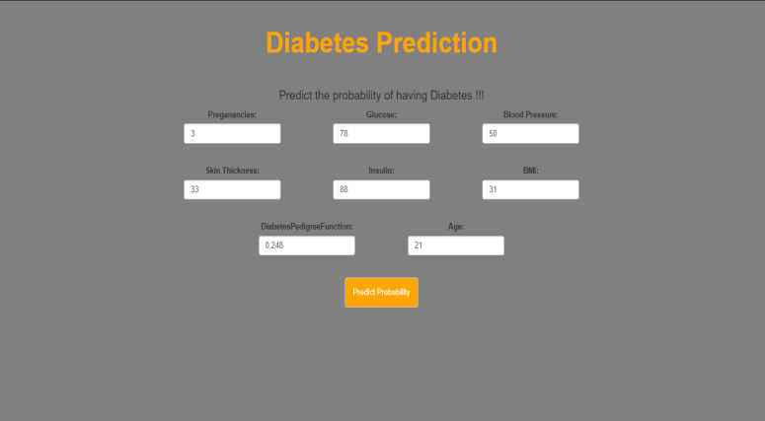
Input

Slide 28
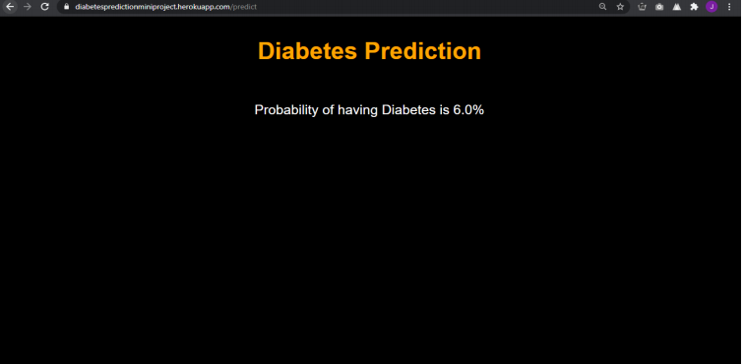
Output

Slide 29
THANKING YOU

